Slide 1
Week 1: Faith & Finances
Aug 4th 2024
LifeGuide Financial Advisors, LLC is a registered investment advisor.

Slide 2
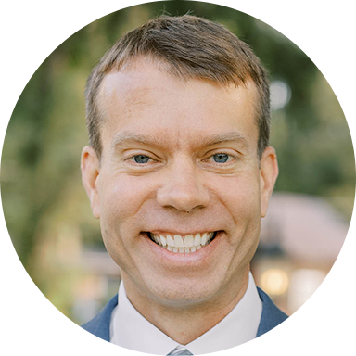
Hi, I’m Zak Lutz.
CFP®, RLP®, CKA® | LifeGuide Partner & Chief Investment Office

Slide 3
Helping families achieve financial peace, freedom, & eternal impact
Notes:
A bit about who we are and what we’re all about as a firm

Slide 4
Journey
Core Biblical Truths
3 Issues
3-Part Stewardship Framework
Discussion
Reflection
(All scriptures ESV)

Slide 5
What does it look like to live out what the Bible says about money?
What should financial planning/investing look like as a Christian?
Faith & Finances

Slide 6
Responsible Financial Stewardship
Give 10 %
Live within your means (i.e., budget)
Have an emergency fund
Get out of debt – Don’t carry a balance on your Credit cards
Create margin - Start early and save a lot for the future
Build even more wealth while enjoying life with no financial worries
Buy and pay
off a house
Retire early
Amount of wealth is the degree to which you were a successful steward

Slide 7
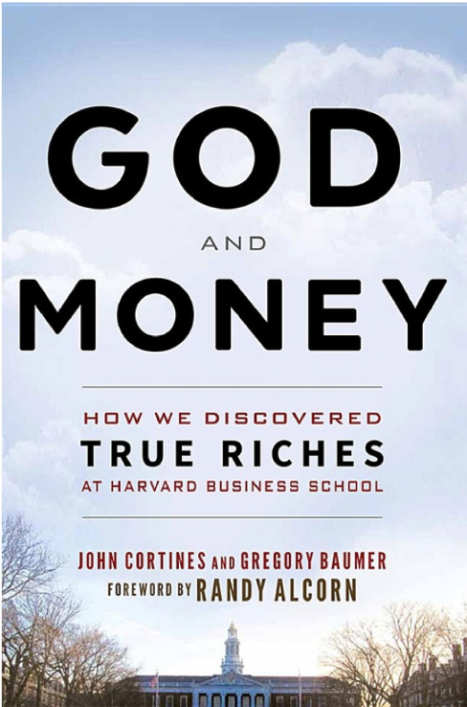
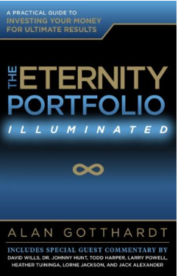
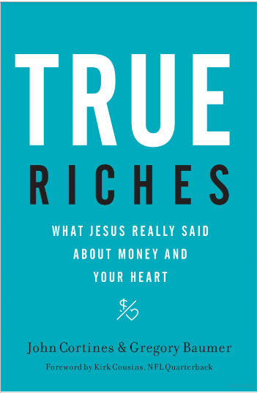
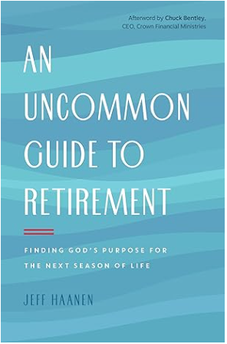
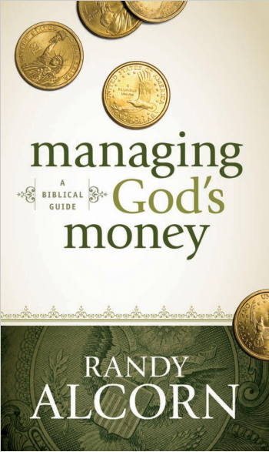
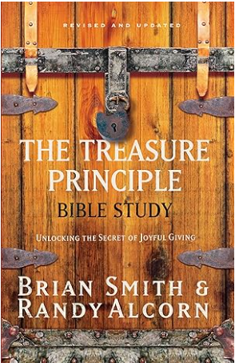
My Journey
Notes:
Remind them on their notecards to check out their notecards for QR code and link to website for resources — lifeguidefa.com/LEFC

Slide 8
Financial Responsibility
Biblical Truth:
Stewardship is a Journey of Surrender
Surrender

Slide 9
Responsible Financial Stewardship
Give 10%
Have an emergency fund
Build even more wealth while enjoying life with no financial worries
Live within your means - Budget
Get out of debt – Don’t carry a balance on your Credit cards
Create margin - Start early and save a lot for the future
Buy and pay
off a house
Retire early

Slide 10
Then Jesus told his disciples, “If anyone would come after me, let him deny himself and take up his cross and follow me. For whoever would save his life will lose it, but whoever loses his life for my sake will find it.
For what will it profit a man if he gains the whole world and forfeits his soul? Or what shall a man give in return for his soul?
— Matthew 16:24-26 (ESV)
Biblical Truth:
Stewardship is a Journey of Surrender

Slide 11
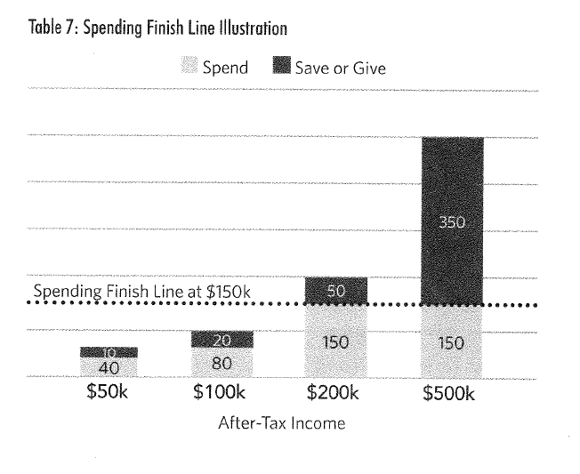
Notes:
IF HAVE TIME or client has interest…Let the first 14 seconds play then jump to 3:52.

Slide 12
Biblical Truth: God owns it all
“It is I who by my great power and my outstretched arm have made the earth, with the men and animals that are on the earth, and I give it to whomever it seems right to me.”-Jeremiah 27:5

Slide 13
Biblical Truth:
Eternity

Slide 15
Biblical Truth:
Sowing & Reaping
Universal law of nature – “You reap what you sow”
Do not be deceived: God cannot be mocked. A man reaps what he sows. — Galatians 6:7
The point is this: whoever sows sparingly will also reap sparingly, and whoever sows bountifully[a] will also reap bountifully. — 2 Cor. 9:6

Slide 16
Eternity & Sowing and Reaping
Sowing
Reaping
Spans the gap of eternity
Eternal rewards

Slide 18
Do not store up for yourselves treasures on earth, where moth and rust consume and where thieves break in and steal; but store up for yourselves treasures in heaven… - Jesus | Matthew 6:19-21
Sell your possessions and give to the poor. Provide purses for yourselves that will not wear out, a treasure in heaven that will never fail, where no thief comes near and no moth destroys. – Jesus | Luke 12:33
Biblical Truth:
Eternal Rewards
Commands

Slide 19
Now after a long time the master of those servants came and settled accounts with them. And he who had received the five talents came forward, bringing five talents more, saying, ‘Master, you delivered to me five talents; here, I have made five talents more.’ His master said to him, ‘Well done, good and faithful servant. You have been faithful over a little; I will set you over much. Enter into the joy of your master.’
He also who had received the one talent came forward,… So take the talent from him and give it to him who has the ten talents.’ Matt 25:19-28
Biblical Truth:
Eternal Rewards
Parables

Slide 20
He (Moses) He regarded disgrace for the sake of Christ as of greater value than the treasures of Egypt, because he was looking ahead to his reward. —Hebrews 11:26-27
Run in such a way as to get the prize. Everyone who competes in the games goes into strict training. They do it to get a crown that will not last, but we do it to get a crown that will last forever. —1 Cor. 9:24-25
Looking to Jesus, the founder and perfecter of our faith, who for the joy that was set before him endured the cross, despising the shame, and is seated at the right hand of the throne of God. —Hebrews 12: 2-3
Biblical Truth:
Eternal Rewards
Role Models

Slide 21
Looking at him, Jesus showed love to him and said to him, “One thing you lack: go and sell all you possess and give to the poor, and you will have treasure in heaven; and come, follow Me. – Mark 10:21
For the Son of Man is going to come with his angels in the glory of his Father, and then he will repay each person according to what he has done. — Matthew 16:27
Each one's work will become manifest, for the Day will disclose it, because it will be revealed by fire, and the fire will test what sort of work each one has done. If the work that anyone has built on the foundation survives, he will receive a reward. If anyone's work is burned up, he will suffer loss, though he himself will be saved, but only as through fire. —1 Cor 3:13-16
Biblical Truth:
Eternal Rewards
Foretelling the Future

Slide 22
3 issues to resolve
1. Spending in the Dot
3. Investing for the LINE
2. Saving for the Dot

Slide 23
We need to be good investors
What do good investors do?
Maximize the amount of money they can invest at the highest possible return/benefit
How?
Delayed Gratification – Forgo a smaller benefit today so they have something to invest for a larger benefit in the future
Knowledge – Know what will produce a larger return
Faith – Believe it will work

Slide 24
3 issues to resolve
3. So you can maximize investments in the LINE
1. Constrain spending in the Dot
2. Constrain saving for the Dot

Slide 25
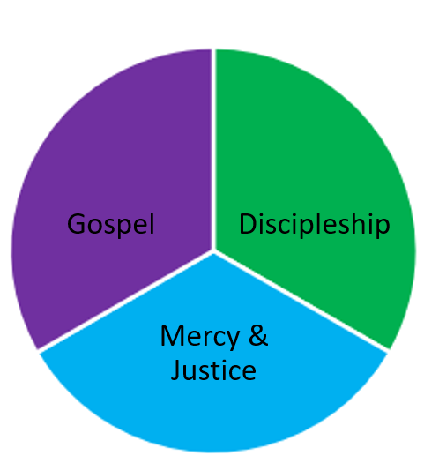
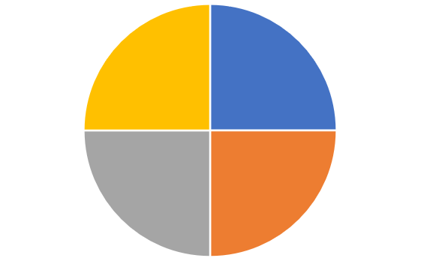
3-Part Stewardship Framework
“Save just enough or a little less for Mid term goals & risks”
Holistic Financial plan for needs on earth – Family portfolio
“Invest all you can for the highest long-term benefit - Eternity”
Make investments in – Eternity Portfolio
“Constrain your lifestyle”
Lifestyle finish line
College funding & other short- term goals
Survivor funding
Long Term Care funding
Retirement funding

Slide 26
Discussion
Why is it so hard for people to live for the line and not the dot?

Slide 27
Reflection
What is getting in the way of you completely "living for the line.“?
What is one step that you can take this week to live with more of an eternal focus?

Slide 28
Join me for part 2: Aug. 25th!
3-Part Stewardship framework in depth
Most common objections

